Slide 1
Figure 1-5 Gaps in Care Reporting Scenario
Request $care-gaps Operation
Client
Server
Return DEQM Gaps in Care Bundle(s)

Slide 2
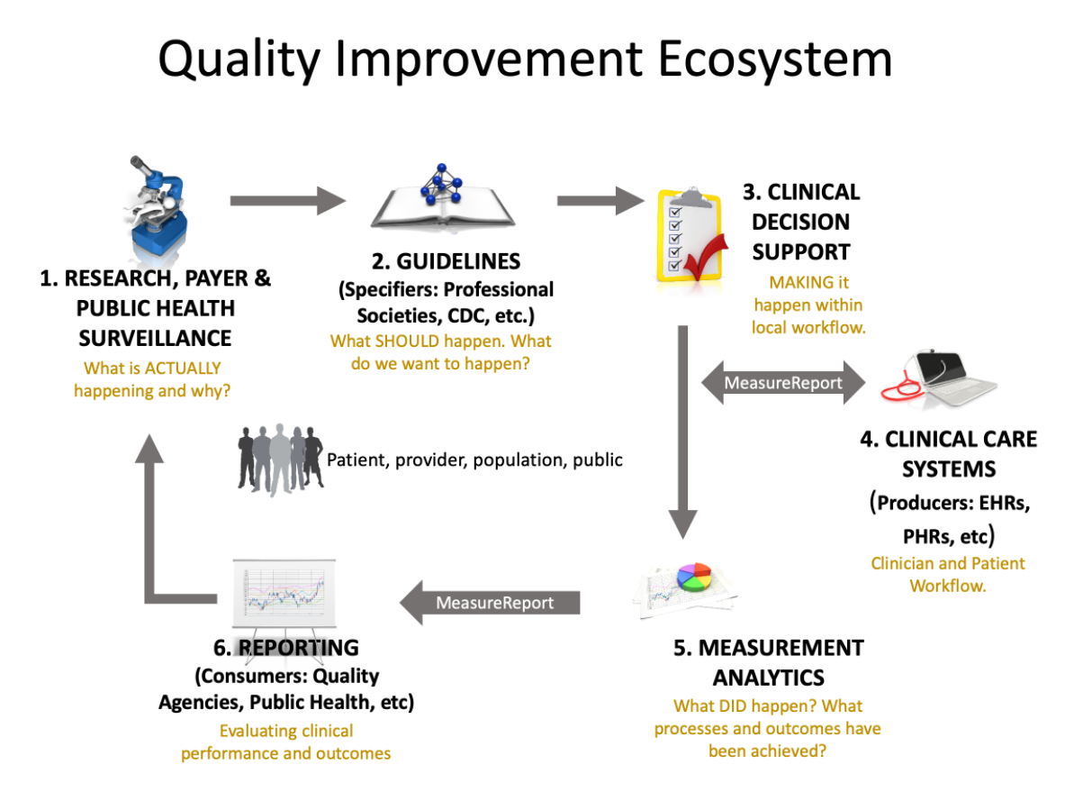

Slide 3


Clinical Care Systems request a report on one or more patient’s Care Gap Information based on Measure(s) criteria
Clinical Care Systems
Measurement Analytics
Provider Workflow
Payer, Reporting Vendor, or internal analytics (etc.) Workflow
Based on the Measure criteria, the Measurement Analytics system, generates a report showing open or closed gaps of Patient(s) for that measure

Slide 4
Gaps in Care Resources
GIC Bundle
GIC Measure Report Pneumococcal Flu Vaccine
Open Gap
Note no data in Server’s system for this patient and measure so no resources returned
GIC Detected Issue
entry
section.entry
entry
patient
QI Core Patient*
Age 63
GIC Composition
GIC Measure Report Breast Cancer Screening
Closed Gap
QI Core Procedure
Bilateral Mastectomy
8/2/2010
Denominator Exclusion
subject
section.focus
evaluateResources
custodian
QI Core Procedure
Colonoscopy
9/10/2018
Numerator
*QI Core Patient is also pointed to by all GIC Measure Reports, QI Core Procedure, and QI Core Lab Observations
QI Core Organization
(example Payer)
GIC Measure Report Colorectal Cancer Screening
Closed Gap
evaluateResources
QI Lab Observation
FOBT
10/1/2019
Numerator

Slide 5
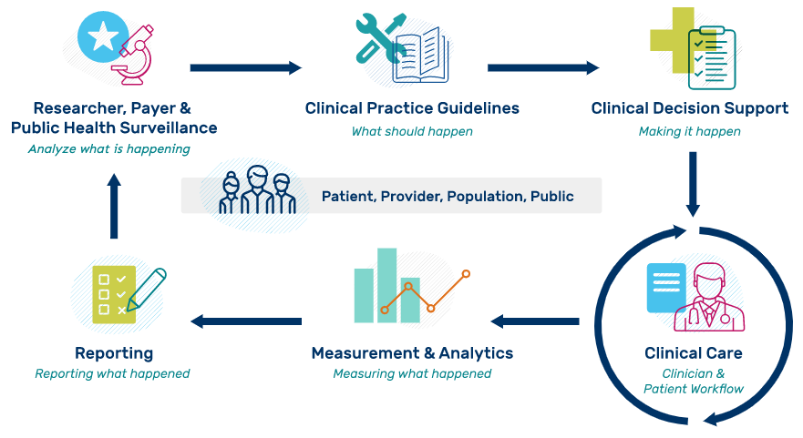

Slide 6


Gaps in Care Request
Clinical Care Systems request a report on one or more patient’s Care Gap Information based on Measure(s) criteria
Payer, Reporting Vendor, or internal analytics (etc.) Workflow
Provider Workflow
Based on the Measure criteria, the Measurement Analytics system, generates a report showing open or closed gaps of Patient(s) for that measure
Gaps in Care Response

Slide 7
DEQM Gaps In Care Bundle
GIC Bundle and entries
referenced resources
GIC Bundle
GIC Composition
(optional)
QI Core Patient
QI Core Procedure
Colonoscopy
entry
subject
entry
evaluatedResource
entry
GIC Measure Report Colorectal Cancer Screening
section.entry
subject
QI Core Lab Observation
FOBT
entry
entry
GIC Measure Report
Colorectal Cancer Screening
evaluatedResource
entry
QI Core Lab Observation
FOBT
QI Core Patient
entry
reporter
QI Core Organization
entry
section.focus
evidence[0].detail
QI Core Procedure
Colonoscopy
GIC Detected Issue
GIC Detected Issue
Guidance Response
evidence[1].detail
Guidance Response
QI Core Organization
Notes:
11/23/2022: Added this slide to address https://jira.hl7.org/browse/FHIR-33175 as part of the STU4-ballot (to show Bundle including all referenced patient resources and detectedIssue as entries)

